Slide 1
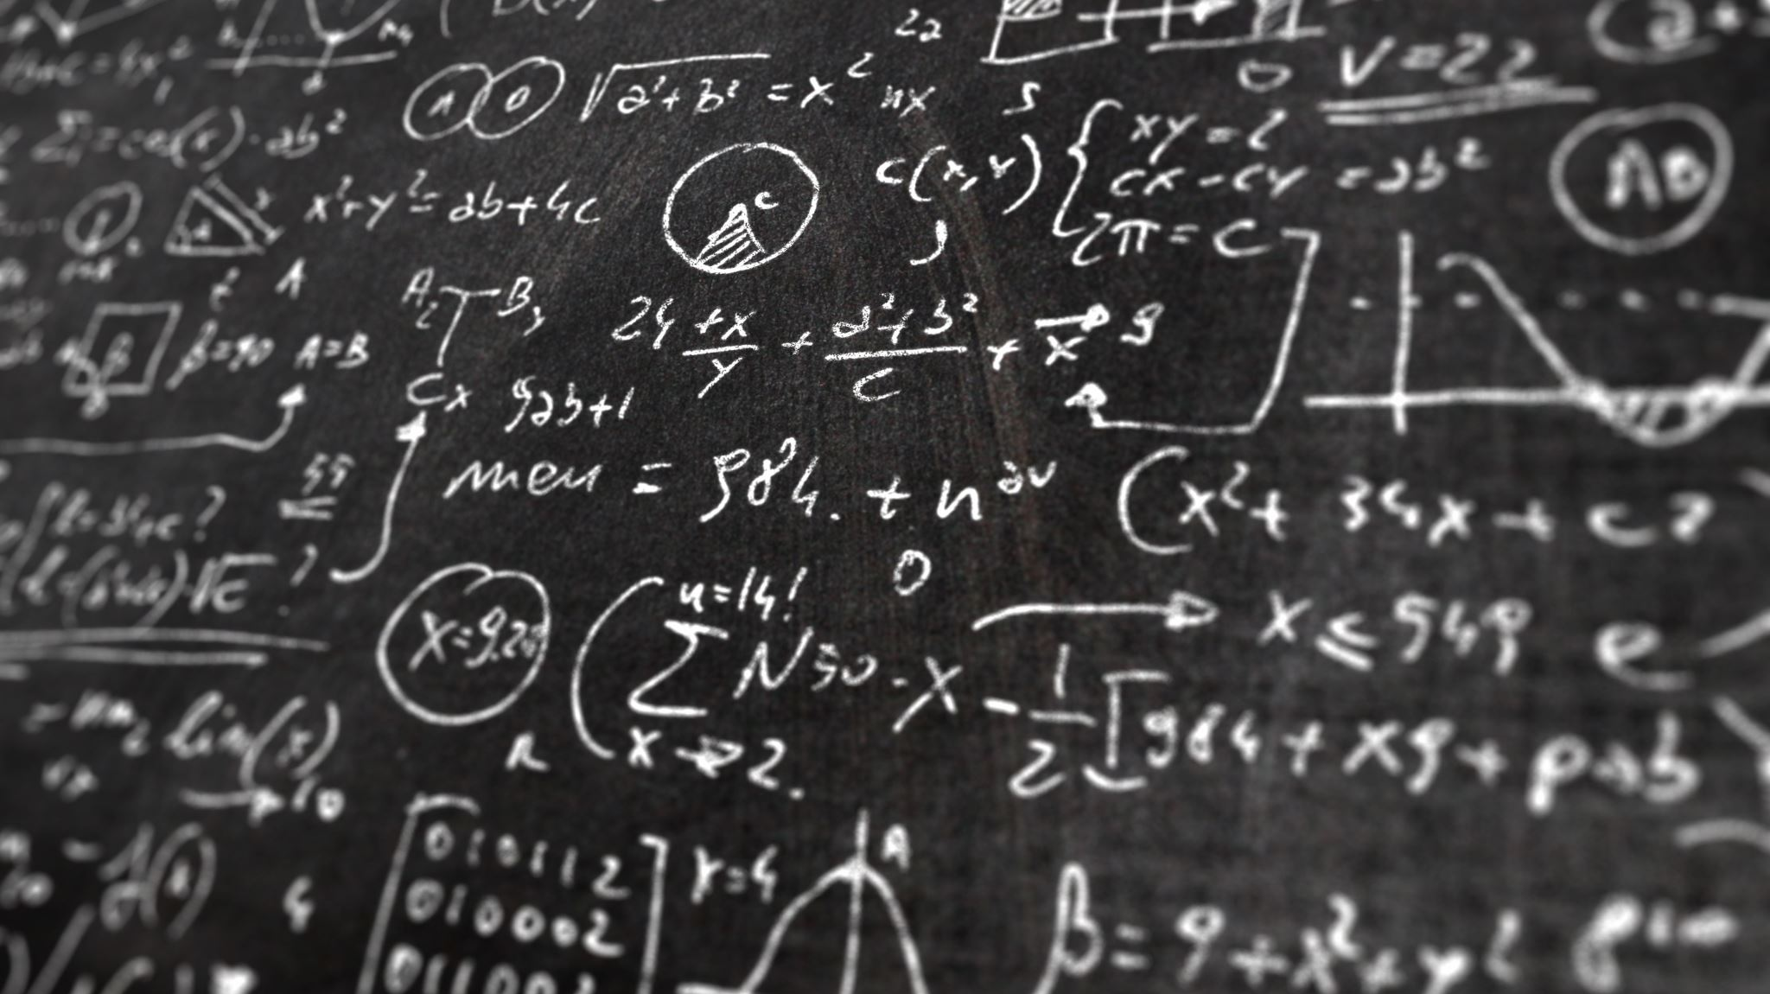
QUORA Identifying Duplicates
NLP / Deep Learning Project
Uche Okechukwu

Slide 2
Overview
Objective
Process
Feature Engineering
Machine Learning
Deep Learning
Results
Conclusions / Recommendations

Slide 3
Objective
Identify which pair of Quora questions are duplicates.
Skills: Deep Learning, NLP,
EDA, Feature Engineering, Machine Learning, etc
Binary Classification problem.
Dataset: 400K records. 3 NULL, no duplicate pairs.

Slide 4



Process
Feature Engineering:
Model Building:
Use of word embedding methods (TfidfVectorizer() and CountVectorizer()) for numerical encoding of text data.
Use of sentence embeddings and derived features from package libraries: Doc2Vec and Tensorflow Hub Universal Sentence Encoder
Also generated common_words feature – the ratio of common words (after preprocessing) between the data fields.
Preprocessing
Cleaning and tokenization of each record. (Used Lemming, not Stemming)
Machine Learning: Used GridSearch to find the best ML classifier (from LinearRegression(), SVM(), RandomForestClassifier(), GradientBoosterClassifier())
Deep Learning: Trained 5 models of increasing complexity to evaluate performance.

Slide 5
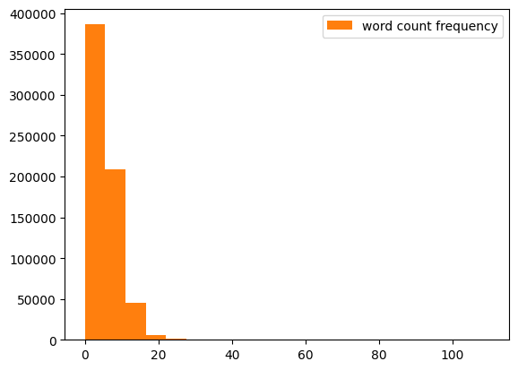
Feature Engineering: cosine_distance from Doc2Vec by Gensim
Similar to Word2Vec but for sentences/paragraphs.
Same semantic relationship as Word2Vec i.e. similar-meaning sentences are mapped near each other in vector space, and associations run in parallel.
Installed untrained. Built and trained the corpus on the Quora training dataset only (to avoid data leakages).
Used pairwise.cosine_similarity from sklearn library to generate cosine_distance feature.
Build the corpus
Train the model
Vectorize the text
Cosine_Distance
Feature
Derive Cosine Similarity

Slide 6
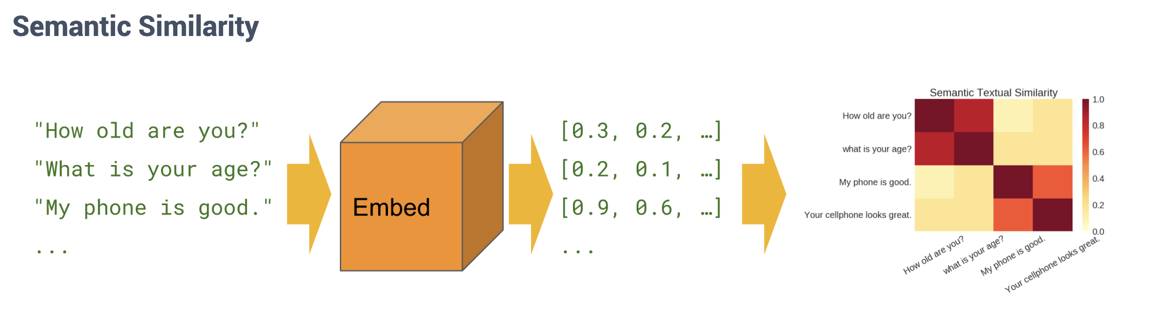
Feature Engineering similarity Universal Sentence Encoder (Tensorflow Hub)
Like Doc2Vec, also turns greater-than-word length text into high-dimensional vectors.
More directly determines semantic similarity between texts.
Used as both embedding layer in model and as a feature generator.
Embed the text
Calculate semantic distance with np.inner()
Similarity
Feature

Slide 7
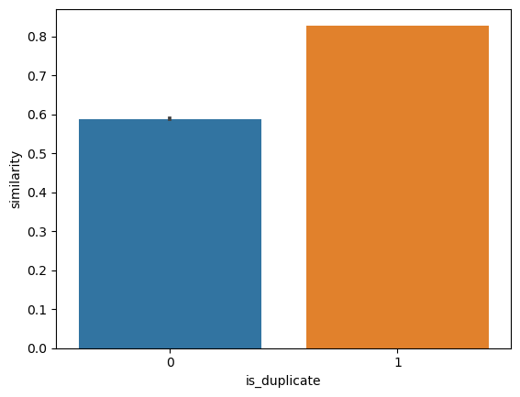
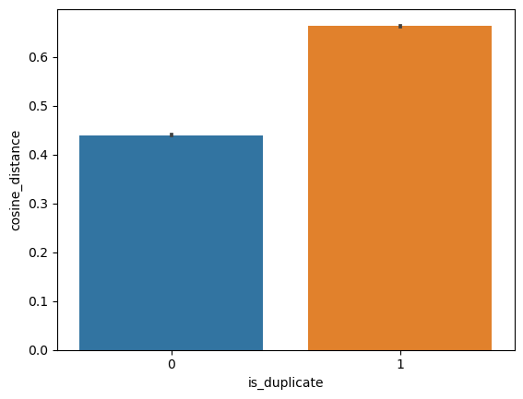
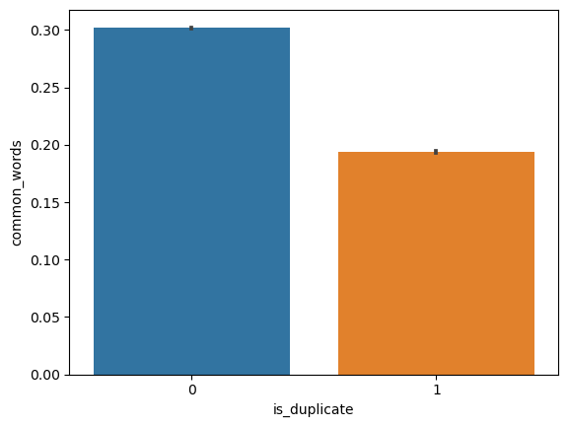
Feature Engineering

Slide 8
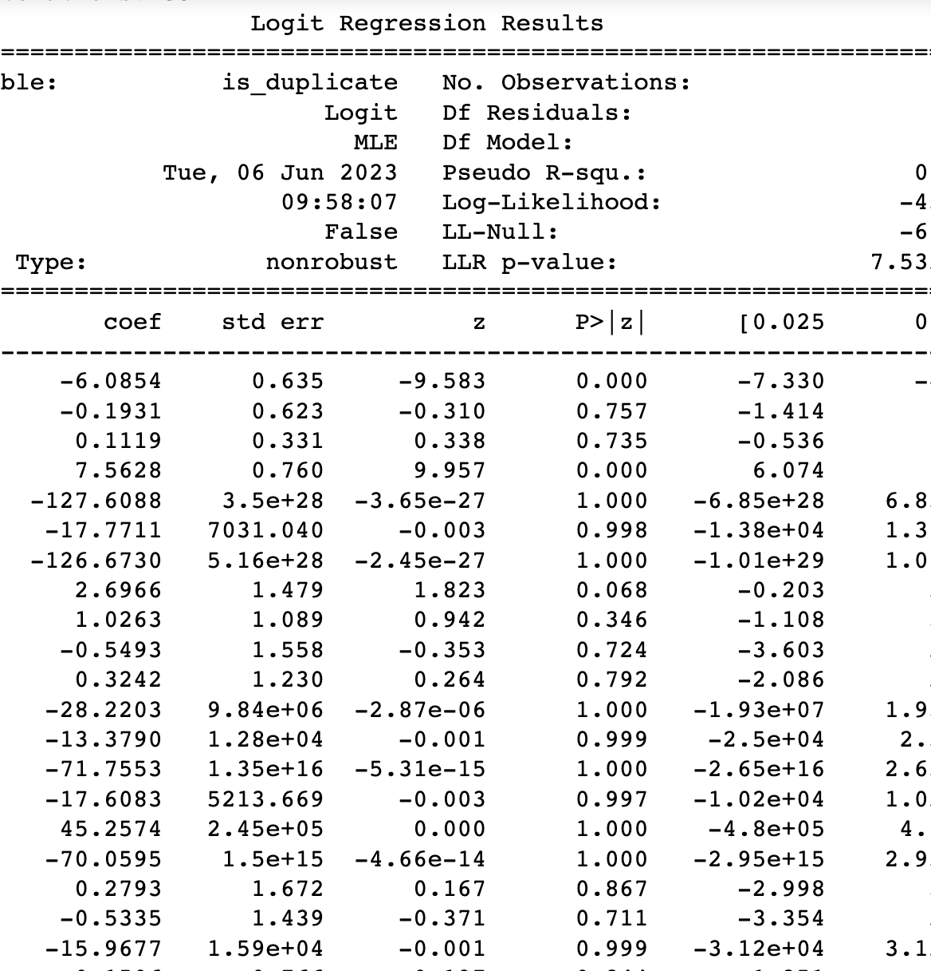
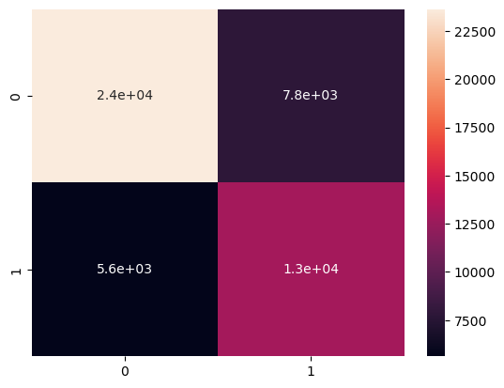
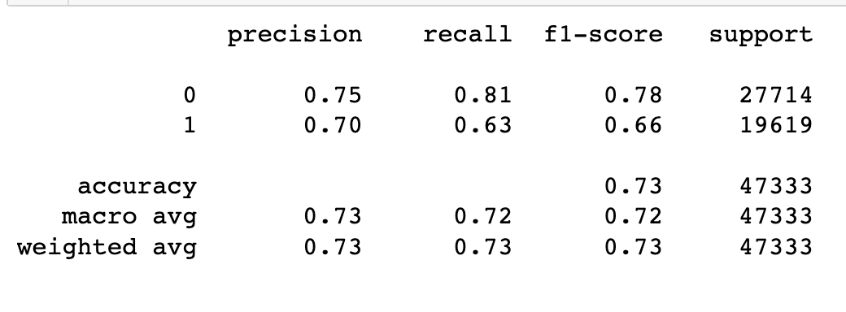
Machine Learning
Baseline Model without additional Features – 0.63
Stats analysis showed high p-scores (low statistical significance) across the embedding vectors. The only feature <0.05 was the similarity feature generated from Universal Sentence Encoder.
Built models with both CountVectorizer() and TfiDVectorizer() as word embeddings. No significant advantage of one over the other.
Best performing model (0.73):
GradientBoostingClassifier()
(max_depth=5, n_estimators = 50)
*debatable due to the difficulty of running GridSearch() across parameters, even on Google Colab.

Slide 9
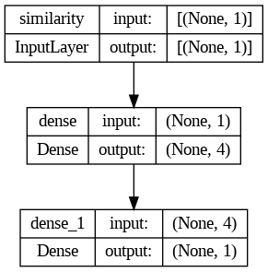
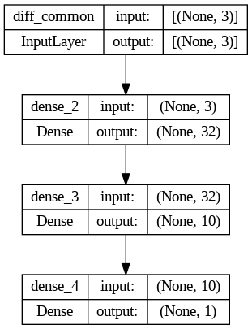
Deep Learning
Strategy: Started with a simple model and added complexity as required to improve performance.
Model 1 – Used the similarity feature as single input. Simple dense network with 1 hidden layer.
Model 2 – Used all the generated features (similarity, common_words and cosine_distance ) as inputs to a dense network.

Slide 10
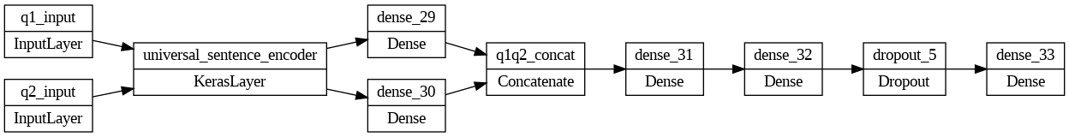
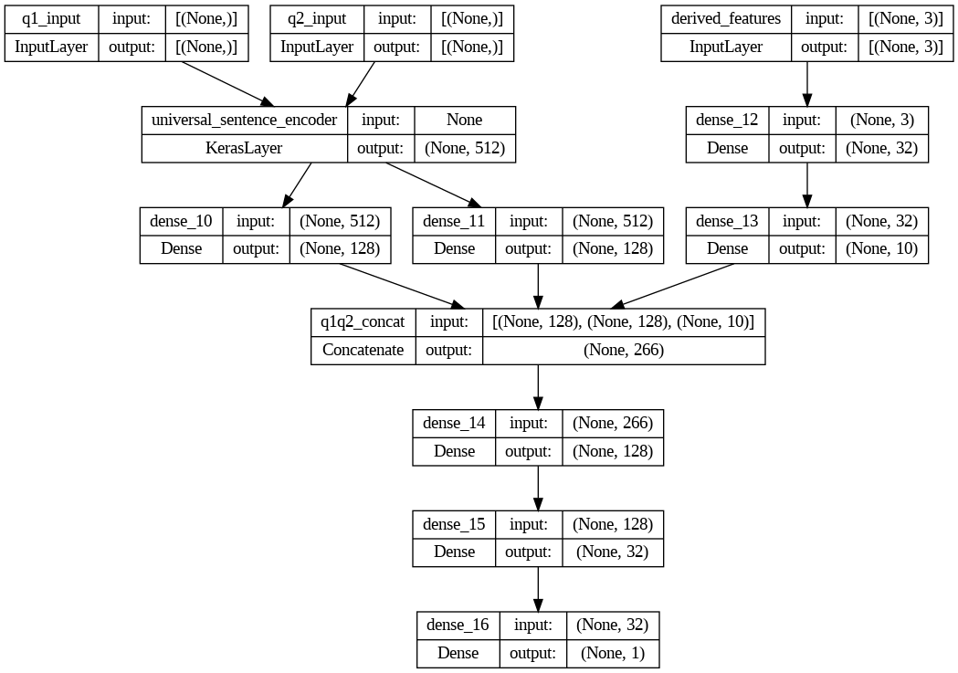
Deep Learning
Model 3 – Used only question_1 and question_2 text features, passed through the Universal Sentence Encoder as an embedding layer in the Dense neural network. Concatenated into two dense layers. Note that the USE performs text preprocessing.
Model 4 – Combination of Model 2 and 3 with all the generated features and the text features into the USE embedding layer.
Model 5 – Similar to Model 4 but with additional Dense layers and Dropout Layers.

Slide 11
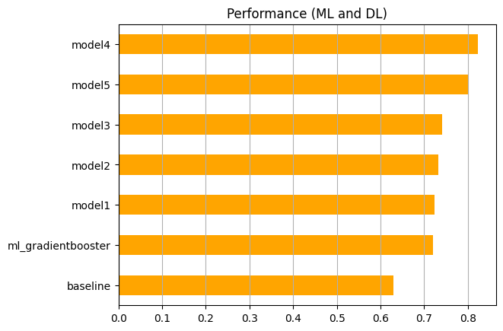
Results
Best performance 0.84, up from the Baseline Score 0.63.
Model 4 gave the best performance across Training and Testing Data.
Model 5 did not improve this score despite its complexity and added layers.
Model 3 (Universal Sentence Encoder as embedding layer) overfitted
Training accuracy peaked at 94%
Test accuracy <75%.
Model 2 and Model 1 both performed about the same ~73%, comparable to the Machine Learning model scores.

Slide 12
Conclusion
Summary:
Interesting and educational especially with respect to NLP and Deep Learning. Discovered new packages, and techniques for working and optimizing with Tensorflow e.g PrefetchDataset
Challenges:
Computationally expensive, even with Google Colab. Took >1 hr to run one model through 15 epochs. Had to limit experiments. Made it harder to fix mistakes.
(Sometimes Colab would shut down for using up RAM! Sometimes for no reason at all. Work from your personal drive and save everything).
Could not run full GridSearch() across parameters for the same reason. Had to break it into smaller searches with a smaller grid.
Unbalanced dataset and incorrectly labelled data.
Realized too late that strategy should have been Active Learning. But this would have also been computational expensive!
Further Work:
Explore the effect of a bi-directional LSTM layer in the neural network.
Re-train Doc2Vec on a larger corpus (Wikipedia) and repeat experiments.

Slide 13

END

Slide 14
